Slide 1

Decoding Rainfall vs Temperature
ETL Project

Slide 2
Objective
Extract
Daily Rainfall for a city (Kaggle.com)
Historic weather for the city (Open Weather API )
Transform
Column names
Month from date
Filter for year 2019
Aggregate rainfall and temperature for months of 2019
Load
Rainfall
Weather
Monthly Aggregates

Slide 3






Summary

Slide 4
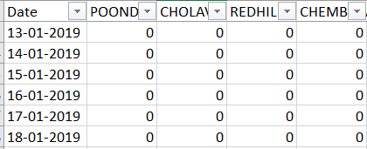
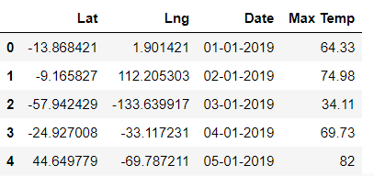
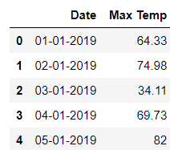
Extract
Rainfall
Using chennai_reservoir_rainfall.csv
Filter for 2019
Weather
Using Open Weather API
Load data for 300+ random latitudes & longitudes
Add date starting from 2019/01/01
Drop Lat and Long colums

Slide 5
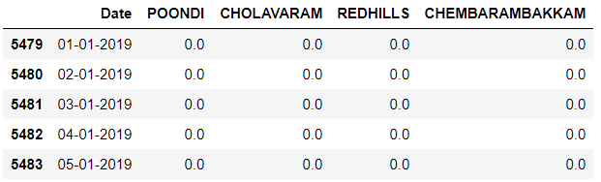
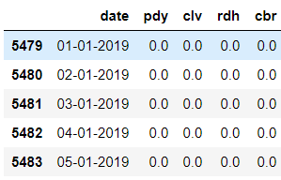
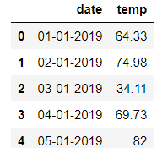
Transform
Rainfall
Rename columns
Replace “/” in date with “-”
Weather
Rename columns

Slide 6
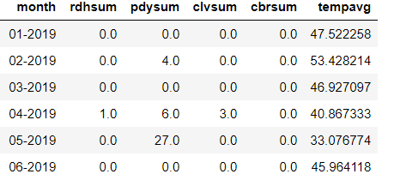
Transform
Rainfall & Weather
Method 1 - Pandas
Join by date
Extract and group by month
Total rainfall
Average weather
Method 2 – Postgres join

Slide 7
Load
Load
Rainfall
Weather
Monthly Aggregate

